Slide 1

Library Management System
A Modern Dual-Interface Solution
Java 25
JavaFX
PostgreSQL
Gradle
UE19 • 2025

Slide 2
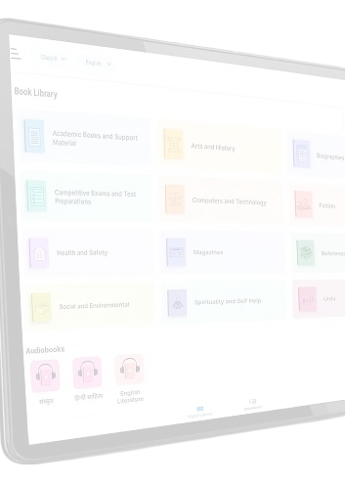
Project Overview
A comprehensive library management solution designed to streamline library operations for institutions of all sizes.
Efficient book tracking and cataloging system
Student/member management with detailed records
Seamless book issue and return workflows
Real-time availability tracking and reporting

Slide 3
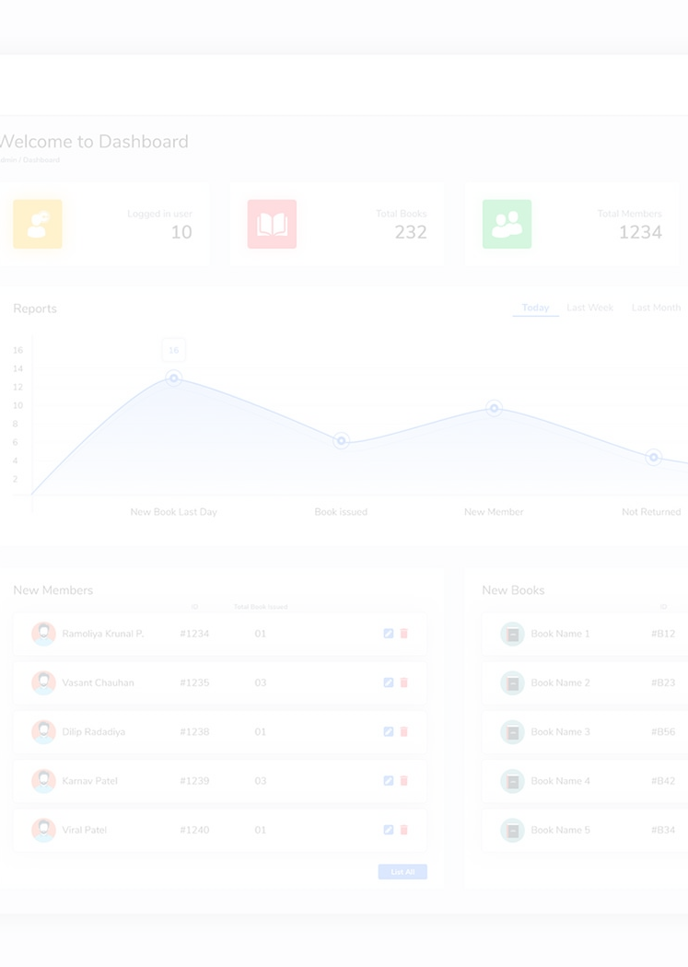


Two Powerful Interfaces
CLI Version
Lightning-fast command-line interface for power users and system administrators
GUI Version
Beautiful JavaFX interface with PostgreSQL database integration for complete data persistence

Slide 4

Core Features
Book Management: Add, search, update, and remove books
Student Registration: Comprehensive member information system
Transaction Handling: Issue and return books with tracking
Fine Management: Calculates fines accurately

Slide 5
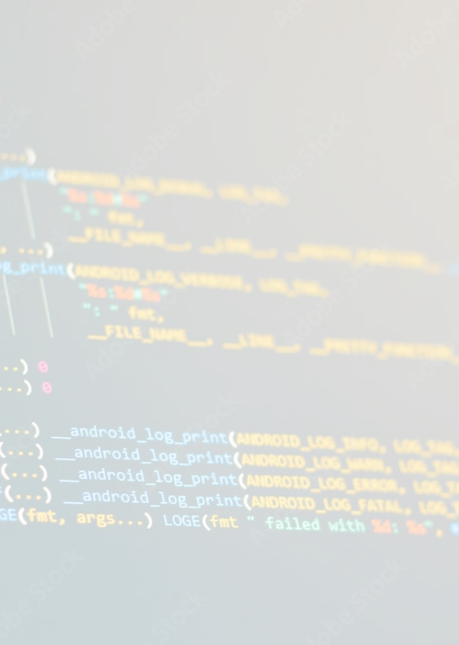
Technical Stack
CLI Version
MVC pattern with in-memory storage using ArrayList data structures
GUI Version
Full MVC with JavaFX, FXML views, and PostgreSQL database layer
Built with: Java 25, Gradle 9.0, JavaFX 21, PostgreSQL JDBC 42.7.2

Slide 6
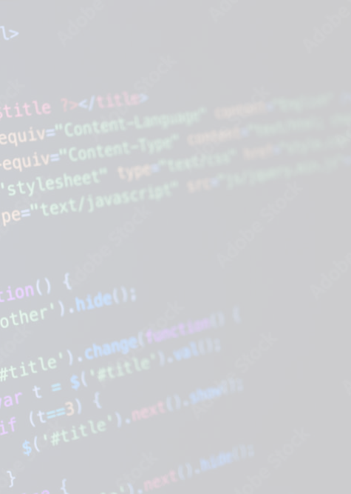
Development Highlights
Modular Design: Clean package structure with model-view-controller separation
Cross-Platform: Runs on Windows, Linux, and macOS
Testing Ready: JUnit integration for quality assurance
Easy Setup: Gradle wrapper for seamless builds

Slide 7




Thank You!
Questions & Discussion
GitHub: github.com/UE19/projectwork_lms-01
Star the repository if you find it helpful!
Built with
using Java & JavaFX

